Slide 1

Basic Details of the Team and Problem Statement
Ministry/Organization Name/Student Innovation: Central Ministry
PS Code: SIH1521
Problem Statement Title: Development of Explainable AI (XAI) based model for prediction of heavy /high impact rain events using satellite data
Team Name: CrypticCoders
Team Leader Name: Harsh Satsangi
Institute Code (AISHE): U0507
Institute Name: Dayalbagh Educational Institutes
Theme Name: Space technology

Slide 2
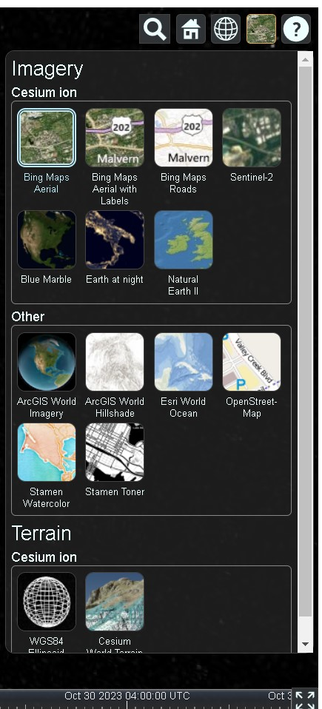
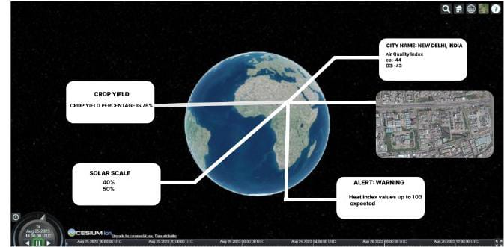
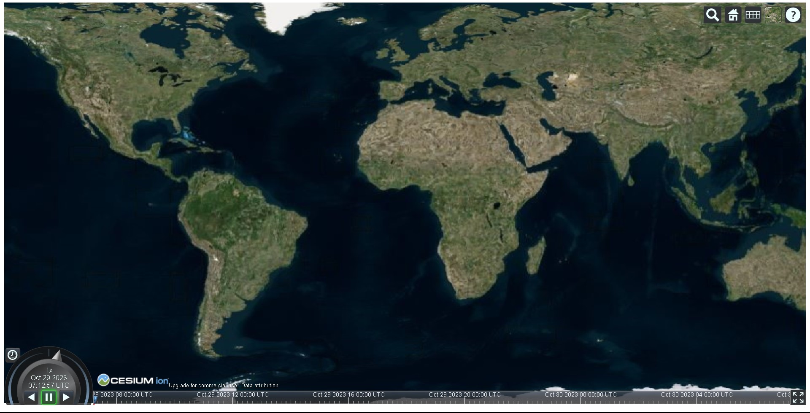
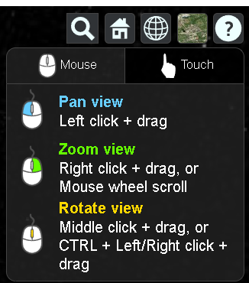
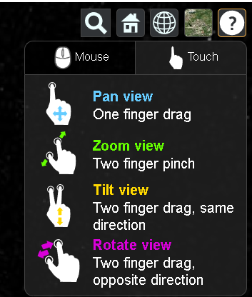




Idea/Approach Details
Describe your idea/Solution/Prototype here:
Introducing SkyWatcher: A cutting-edge AI platform for real-time disaster prediction, air quality assessment, solar potential evaluation, and climate forecasting. Powered by INSAT-3D/3DR satellite data, our AI model accurately predicts high-impact rainfall events, ensuring enhanced safety and preparedness. Transparency is key with our Explainable AI (XAI) module, offering users insights into forecasts. The user-friendly web app provides instant access to air quality index, disaster predictions, solar scores, and climate projections. Plus, it includes accuracy assessments for added confidence. SkyWatcher is set to revolutionize Earth analysis, empowering users with proactive environmental insights.
Describe your Technology stack here:
Air Quality Prediction:
Utilizes satellite data for real-time monitoring of air quality parameters.
Employs data analytics and machine learning for accurate predictions.
Weather Prediction:
ML models process historical and real-time satellite weather data.
Predicts temperature, precipitation, wind speed, and humidity for specific regions.
Weather Alerts:
Integrates predictions to generate timely weather alerts.
Notifies users about impending weather events.
Solar API:
Factors in location, sun angle, and weather for solar energy potential.
Provides an API for assessing solar installation viability.
User Tools:
Design: Figma
Website: HTML, CSS, JS

Slide 3
Idea/Approach Details
Describe your Use Cases here
Urban Planning & Infrastructure:
Improve city layout efficiency with high-resolution satellite imagery.
Precision Agriculture for Food Security:
Optimize farming decisions with crop health and soil data.
Environmental Monitoring & Conservation:
Track changes in forests, water bodies, and ecosystems for conservation efforts.
Global Connectivity & Disaster Response:
Utilize satellites for real-time monitoring in remote or disaster-prone areas.
Sustainability & Renewable Energy:
Enable eco-friendly choices with real-time air quality and solar potential data.
Education & Research Access:
Provide geographic and environmental data for academic and research purposes.
Describe your Dependencies / Show stopper here
Satellite Data Reliability:
Dependency: Reliable access to high-quality satellite data is crucial for accurate predictions and monitoring.
Machine Learning Model Training:
Dependency: Effective training of ML models requires a substantial amount of historical and real-time data.
Regulatory Compliance and Permissions:
Dependency: Ensuring compliance with regulations and obtaining necessary permissions for data usage and distribution.
Technical Infrastructure and Bandwidth:
Dependency: A robust technical infrastructure and adequate bandwidth are essential for processing and transmitting large volumes of data.
Data Security and Privacy Measures:
Show Stopper: Implementing robust security measures to safeguard sensitive environmental data from unauthorized access or breaches.
Weather and Environmental Variability:
Show Stopper: Unpredictable weather patterns and environmental shifts can affect the accuracy of predictions and assessments

Slide 4
Team Member Details
Team Leader Name: Type Your Name Here
Harsh Satsangi B.Tech(ME) Year (III)
Team Member 1 Name: Type Your Name Here
Ansh Prasad B.Tech(EE) Year (III)
Team Member 2 Name: Type Your Name Here
Avichal Yadav B.Tech(EE) Year (III)
Team Member 3 Name: Type Your Name Here
Rashmi Singh B.Tech(EE) Year (III)
Team Member 4 Name: Type Your Name Here
Mantripragada Sabda Pyari B.Tech(EE) Year (III)
Team Member 5 Name: Type Your Name Here
Aditi Satsangi B.Tech(EE) Year (III)
Team Mentor 1 Name: Type Your Name Here
Category (Academic/Industry): Expertise (AI/ML/Blockchain etc): Domain Experience (in years):
Team Mentor 2 Name: Type Your Name Here
Category (Academic/Industry): Expertise (AI/ML/Blockchain etc): Domain Experience (in years):

